Slide 1
Enverus Market Price Indices Analysis Case Study
H.S.MAHIMA

Slide 2
MARKET PRICE INDICES BY BASIN
Objective:
Understand the thematic trends associated with oil well cost components associated with some regions in the United States and develop informed predictions on the same.
Abstract
Pricing differs in various region depending upon the production and how it reaches out to the supplier chain and does produced good consumed by the buyer satisfies the responsible operations. So it has become more important than ever to streamline efforts and gain visibility into your spend in different markets. Traditional approaches cannot help in supply chain strategy because they don’t inform you on pricing trends.
Description of Dataset
The datasets consists of 4524 rows and 8 columns it does not have any missing values the Index category says price spend on particular operations,Sub category various operations on well cost index used in two basins,Index is the Monthly Median price of all the prices for a category in a given region, Phigh is 75th Percentile value or the highest market price value in that month, Plow is 25th Percentile value or lowest both price benchmarked to the Index Baseline,Region has two basins which is oil well regions in US,Type is whether it is normalised price for a normal operation.

Slide 3
Introduction
Pricing on goods and services vary by market and geoghraphical regions making it challenging to keep up and to ensure getting the best pricing possible.Understand the market trends is critical for cost optimisation and planning purposes.In this various categorical index shows how this indcies perform and behave making it for the buyers and suppliers easy.This may lead the new companies to can compare their own pricing on various categories of goods or services to market indices in a specific region.
MARKET PRICE ANALYSIS
First lets see how the datasets look like and the information regarding the same, This index and other curves are created from a large repository of transactional data in the oilfield. The Index column in the Monthly Median price of all the prices for a category in a given region
The median was calculated on a monthly level for every category-subcategory combination since January 2018. This was then normalized the Value of January 2018 for the respective category-subcategory pair and multiply by 100.
 | Plow | Index | Phigh
count | 4524.000000 | 4524.000000 | 4524.000000
mean | 78.355802 | 103.623691 | 140.714052
std | 23.198859 | 33.392147 | 58.592580
min | 19.510000 | 38.790000 | 40.850000
25% | 65.332500 | 90.932500 | 111.257500
50% | 80.585000 | 100.730000 | 127.565000
75% | 92.610000 | 112.372500 | 157.832500
max | 201.440000 | 522.150000 | 768.100000

Slide 4
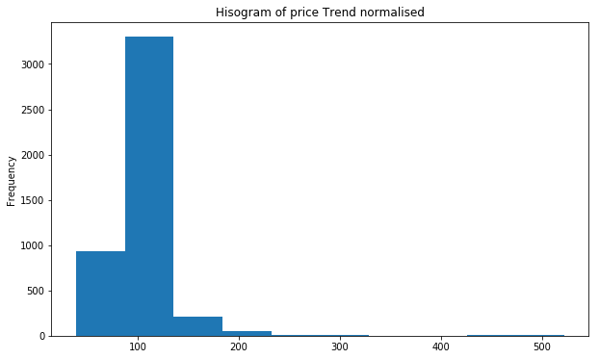
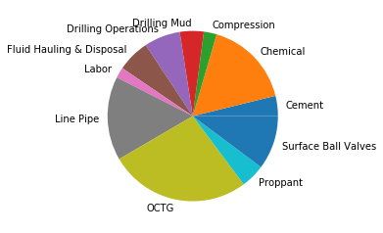
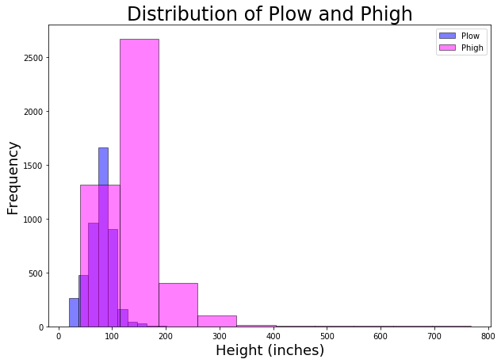
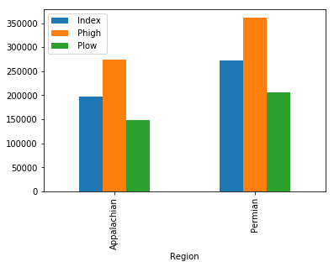
DETAIL ANALYSIS OF PRICE INDICES
Well cost Category Distribution
Group By Basin Price Index

Slide 5
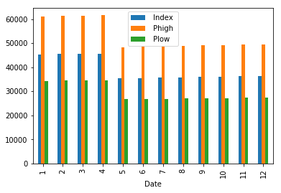
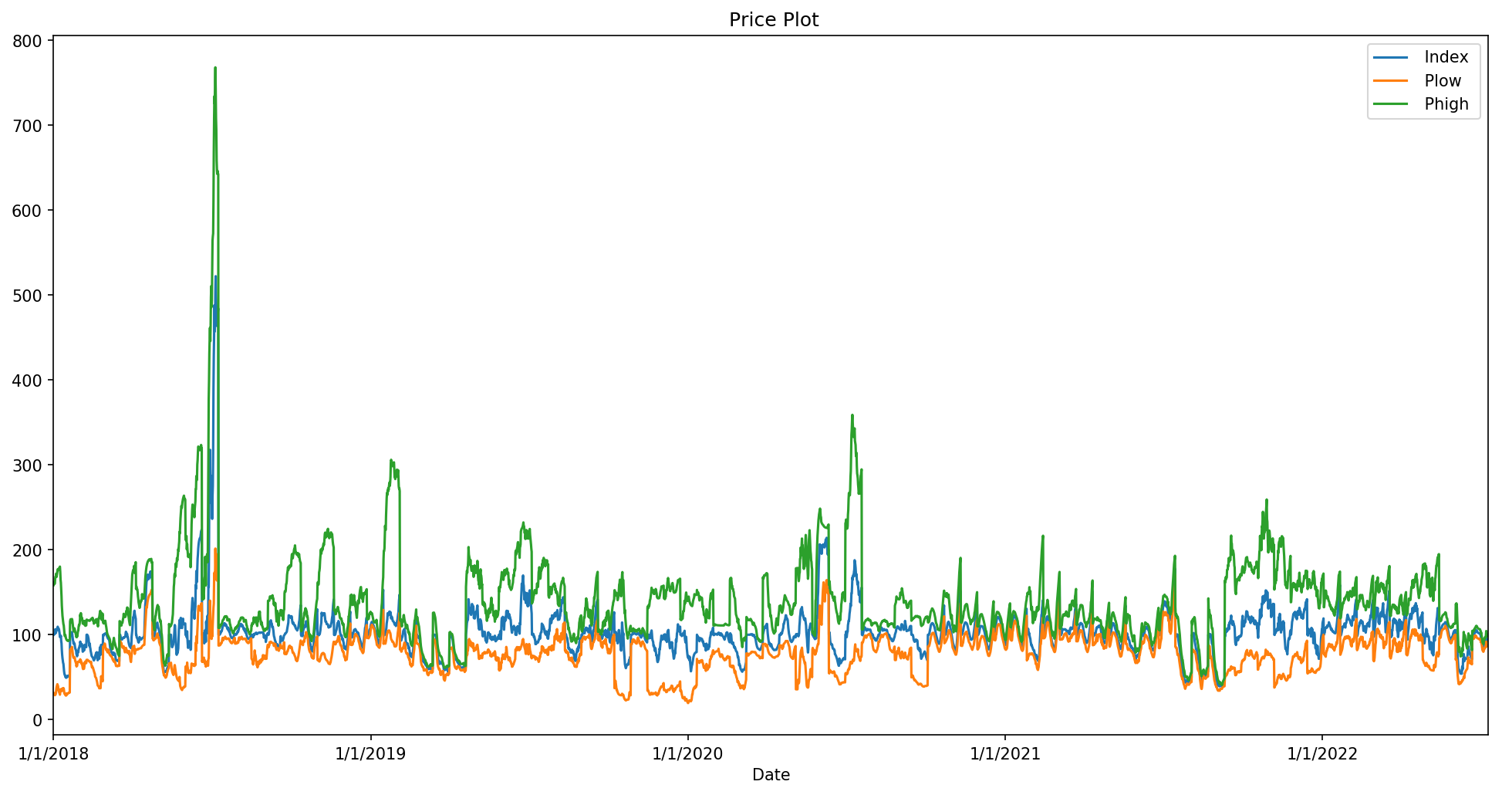
Histogram Grouping Months
Looking on the price pattern and trend

Slide 6
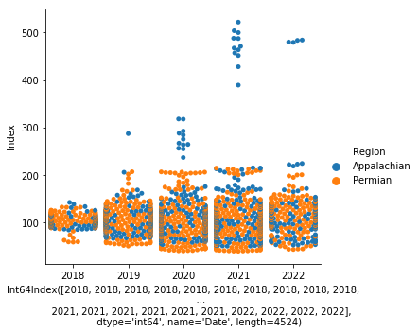
Comparing the commanalities of price trends by Basins
A market pricing comparison in the Permian Basin to the Appalachian Basin is a perfect of how both buyers and suppliers can benefit from regional price trend analysis. The price variation in the Appalachian is much smaller than the Permian. This is because, while both areas have high activity, Appalachia is a very tightly controlled market with fewer supplier options for down hole and drilling.

Slide 7
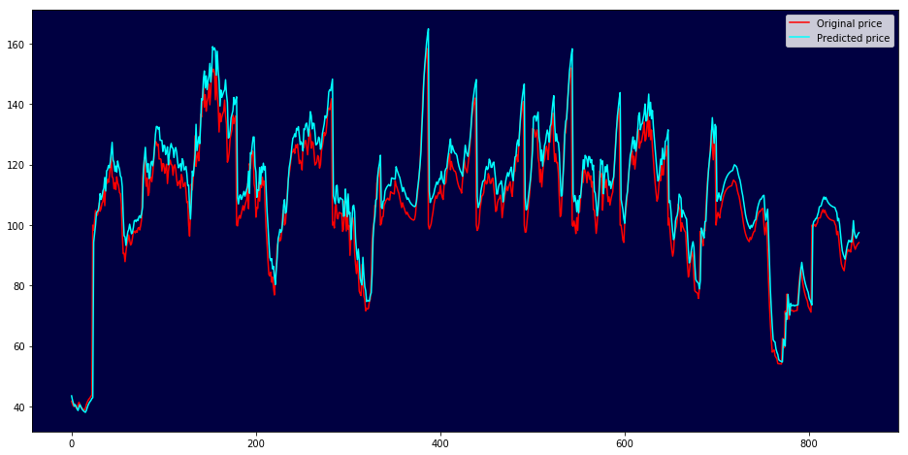
Enverus Market price predictor
As we validated the predicted price trend it seems the market indicies predictor have captured more than 95% of the predictions correctly. So we can say Enverus Market indicies provide visibility into the impact of price changes on individual parts of complex services in different Basins.

Slide 8
SUMMARIZING AND SOLUTIONS FOR THE PROJECT
Are there commonalities there?
Yes,there are commonalities since categorical and numerical variables are grouped in a way that each price index shows high dependent rate,some might be of basins location and other might be which well cost components (example 100 mesh permian index) operates and how it influence price index .
Can we “group” these commonalities?
we can create many group trends and themes related to the variables in this case study I particulary grouped ‘Index’ and ‘Phigh’ with the regions because the correlation plot showed a high relationship between both variables,we can also group the well cost sub category column with index column to see how each indicies price trends look like and which is better for further use.
Does that tell us something meaningful about the greater market trend?
Better Understanding of how trends evolve can reveal new business opportunities and signal market changes.So that the buyers and suppliers can have maximum benefits this provides the working relationships in both sides be stronger and can move their companies forward in future.

Slide 9
What does this “group” trend look like in the future? Why?
As we compare index pricing by regions or basins, the predictor till year 2022 shows a fair predictions alongside the original values so in future it has chances of performing well in the market also helps to imporve strategic pricing and reduce overspend risk.
Do these Indices/time series of “groups” relate to external market indicators.
From customers point of view with these insights they can discover their market price with enverus market price and see how the deviations of market trends varies in both and which one is better.
What could be good indicators for US oil and gas industry?
From the given understanding I would say the level of production, consumer demand and inventory level of oil and gas products are the leading indicators.
What are other indicators? US inflation rates?
One of the most popular indicators used by oil traders is the crude inventories (stock levels), which is the amount of oil currently stored for future use,and growing economic strength. Higher inflation rates tend to lead to higher oil supplies.

Slide 10
Can we use any or all of these to create a narrative?
It depends on time frame and other characteristics features on how one wants tell the story of the dataset given, but the key points and understanding should be provided in a way that even a third party individual who reads the narrative should understand the key insights or the overall outlook and able to take points from it.
Conclusion
To conclude, Enverus market price indicies provide insights both for buyers and suppliers where the buyers can see deviation from market trends, understand the economic impacts of pricing, uncover specific opportunities for additional cost savings, negotiate pricing agreements with suppliers and forecast future trends. For suppliers making the pricing analysis easy and sustainable also makes it more efficient to extract resources. This helps maximize the value generated from this analysis and also acts as a prescriptive system, driving strategies in poor performing areas.

